Slide 1


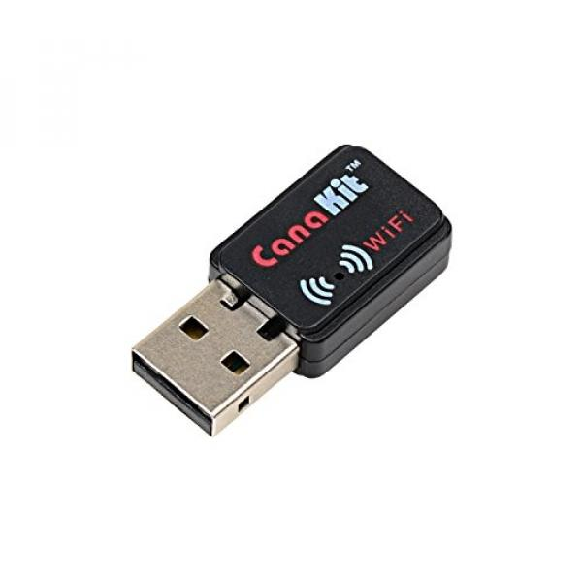


WiFi Connection notes:
Private IP Address (10.0…)
LED on the WiFi dongle shows network connection
Can be configured to automatically connect to a network
Can connect via telnet (requires installation) or ssh
Bluetooth Connection Notes:
169… IP Address
Max Bluetooth Connections:
5 to Mac
1 to PC

Slide 2
Install Telnet
Telnet is insecure, but the EV3s have private IP addresses
Install on EV3
Updates the package list
sudo apt-get update
Install Telnet package
sudo apt-get install telnetd
Install & Connect on Mac
Use Homebrew to install telnet
brew install telnet
Connect with Telnet
telnet -l robot <ip address>
Password: maker
Using Telnet in Python

Slide 3


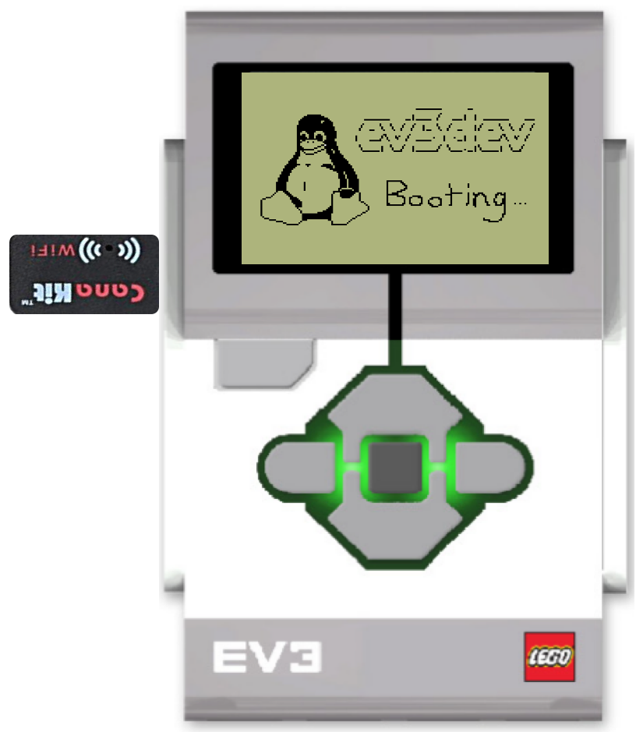
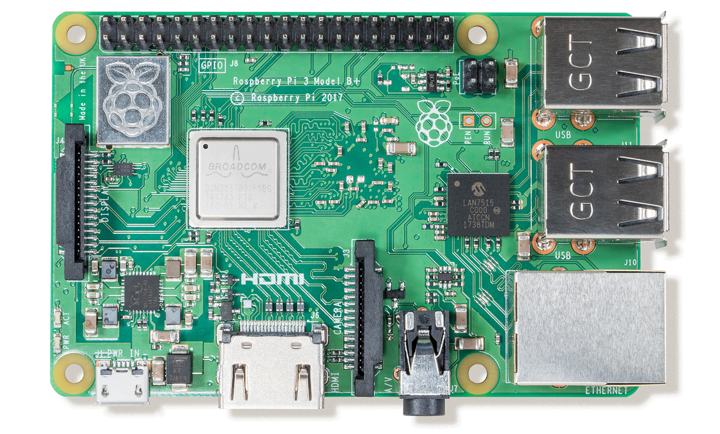
Wireless Network
RasPi reads IP addresses on the network and identifies EV3s
MacBook sends commands via local webserver
EV3s connect to the wireless network on startup
RasPi publishes local webserver
RasPi sends python3 commands to EV3 via telnet based on inputs to webserver
Open webserver, select EV3, & enter commands
EV3s Running EV3Dev with CanaKit WiFi Dongles
Raspberry Pi
MacBook
Hardware
Wireless Network
Programming
User Inputs

Slide 4
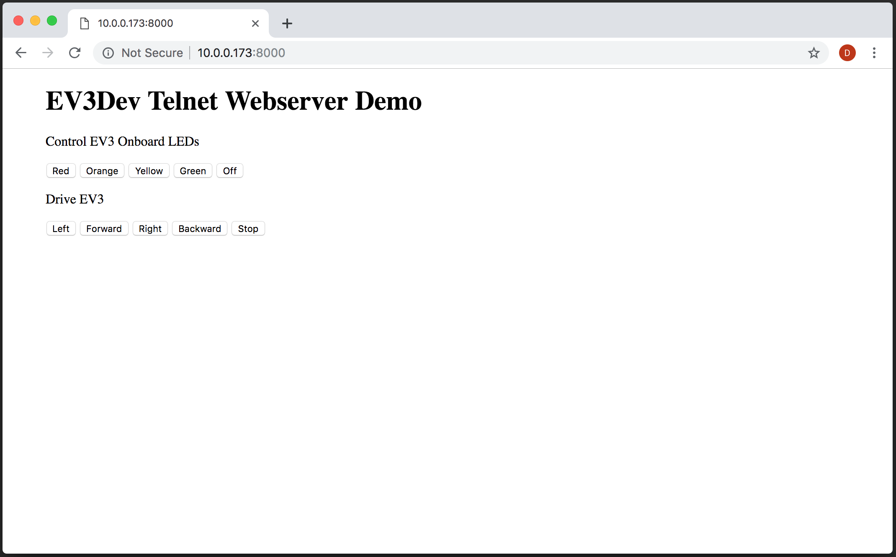
Webserver Demo
EV3 Setup
Configure EV3s to automatically connect to the wireless network
Raspi Setup
Connect to wireless network
Run WebserverDemo.py using python3 (should run on startup)
MacBook Setup
Once the connection between the EV3 & RasPi is initiated and the webserver is created, navigate to <raspi IP>:8000

Slide 5
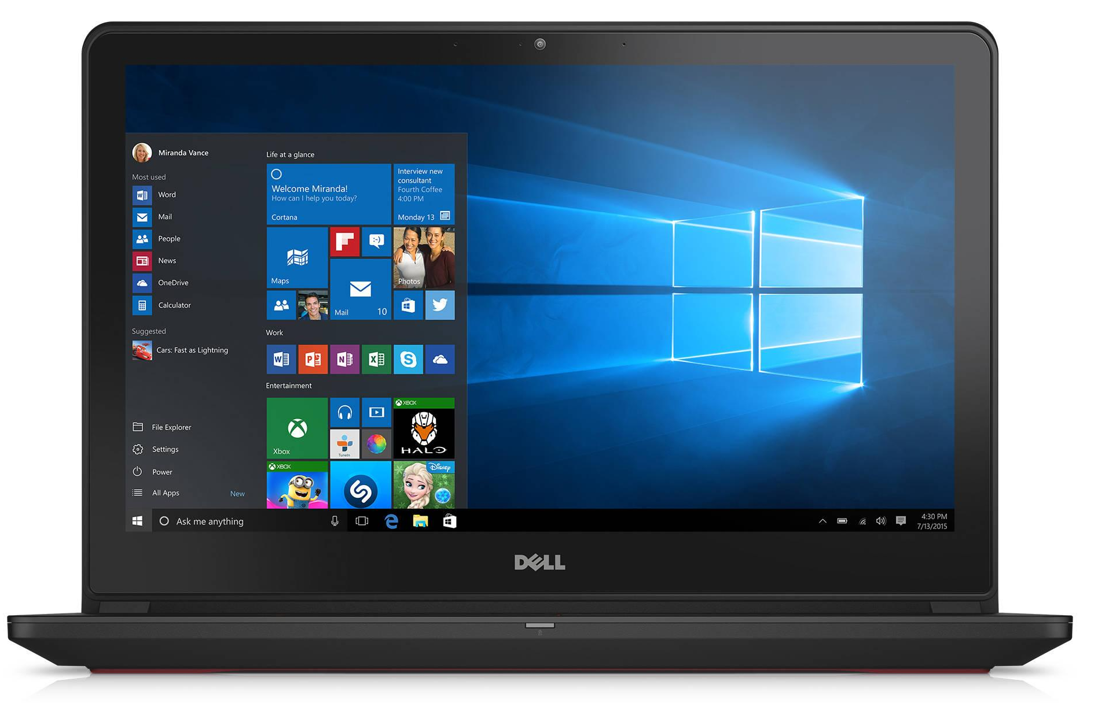
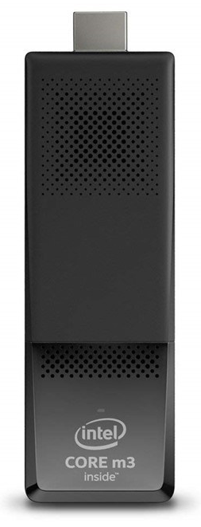
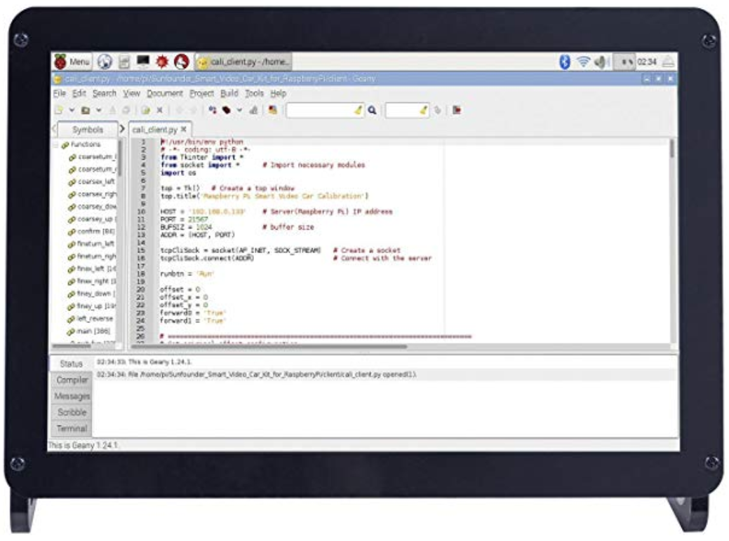
Telnet
Tufts Wireless
Serve Webpage to control EVs
Read EV3 IP Addresses
EV3s Running EV3Dev with CanaKit WiFi Dongles
Intel Stick &
10.1" IPS Display Panel
Student Computers
Hardware
Wireless Network
Programming Task

Slide 6
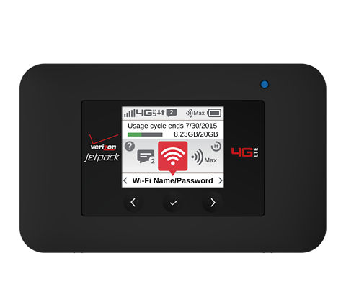
Telnet
Local Area Network
Internet
Serve Webpage to control EVs
Read EV3 IP Addresses
Broadcast LAN
Verizon 4G Jetpack
EV3s Running EV3Dev with CanaKit WiFi Dongles
Intel Stick &
10.1" IPS Display Panel
Student Computers
Hardware
Wireless Network
Programming Task

Slide 7
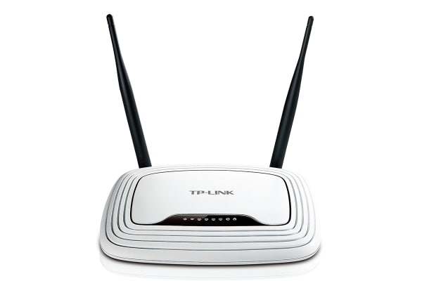
Telnet
Local Area Network
Internet
Serve Webpage to control EVs
Read EV3 IP Addresses
Broadcast LAN
Verizon 4G Jetpack
*
EV3s Running EV3Dev with CanaKit WiFi Dongles
Intel Stick &
10.1" IPS Display Panel
Student Computers
Hardware
Wireless Network
Programming Task
*Router may be needed for LAN

Slide 8

Telnet
Local Area Network
Internet
Serve Webpage to control EVs
Read EV3 IP Addresses
Broadcast LAN
Verizon 4G Jetpack
*
EV3s Running EV3Dev with CanaKit WiFi Dongles
Intel Stick &
10.1" IPS Display Panel
Student Computers
Hardware
Wireless Network
Programming Task
*Router may be needed for LAN

